Slide 1

AUTOMATIC PLANT DISEASE PREDICTION
SUBMITTED BY :-
Name : Km Neha Andola
University Roll No. : 2018888
UNDER THE MENTORSHIP OF –
ASST PROF ARNAV KOTIYAL

Slide 2
INTRODUCTION
The interplay of agriculture and plant diseases greatly affects the Indian economy and the life of farmers.
The degree of severity of the disease determines the extent of the damage caused to plants and can significantly affect agricultural productivity.
Deep learning, especially convolutional neural networks (CNNs), demonstrated remarkable abilities in analyzing and interpreting complex patterns within images, making it an ideal tool for plant disease identification and severity assessment.

Slide 3
DEEP LEARNING MODEL
A subset of machine learning.
Involves training artificial neural networks with multiple layers to learn and predict from complex data.
Performs end-to-end learning.
Deep learning model used here is CNN.
CONVOLUTIONAL NEURAL NETWORK (CNN)
Widely used for computer vision tasks, especially in image recognition and analysis.
Key components are:-
1. Convolutional Layer
2. Pooling Layer
3. Activation Function
4. Fully Connected Layer
5. Loss Function
6. Optimizers

Slide 4
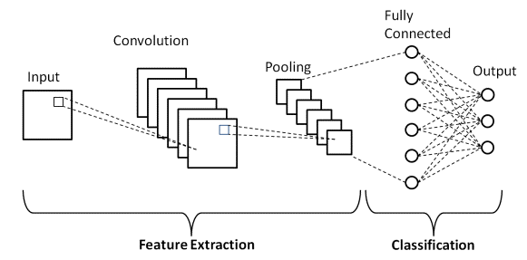
designed to automatically learn and extract relevant features from input images to make accurate predictions or classifications.
Figure 01 : CNN Architecture

Slide 5
VGG19
A deep CNN architecture developed by the company Visual Geometry Group (VGG) at the University of Oxford.
The "19" in VGG19 represents the number of layers in the network, inclusive convolutional layers, fully connected layers and pooling layers.
PROBLEM STATEMENT
The main purpose is to detect the diseased part of the plant leaf. Using Python, CNN are implemented in order to classify the diseased part. Aim is to detect the diseased part by finding whether a particular image belongs to that particular class of disease.

Slide 6
METHODOLOGY
APPROACH
The methodology used here is to train CNN model using a dataset and accurately assess the plant disease.
STEPS
Importing important tools and framework and libraries -
a. Tool - Google Colaboratory
b. Framework and Libraries -
1. TensorFlow
2. Keras
3. NumPy

Slide 7
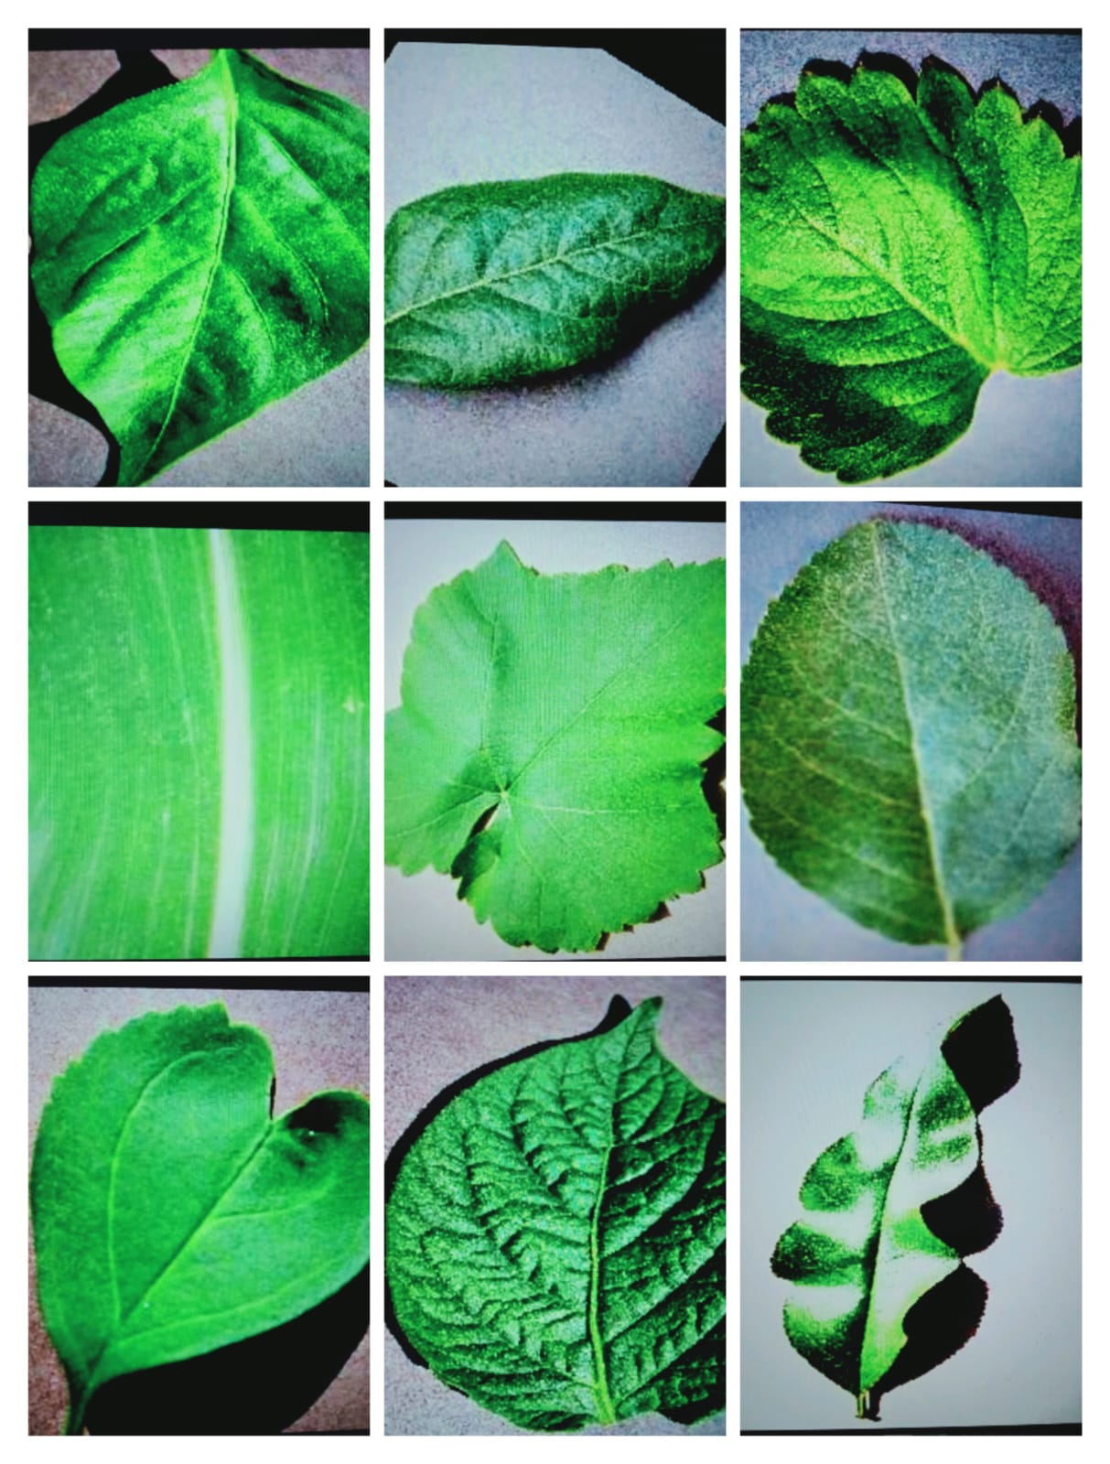
4.Panda
5. Matplotlib
6. Os
Dataset Collection - Obtained from Kaggle.
a. It includes multiple plant species and different disease types.
b. Consists of 87000 RGB images classified in 38 classes.
Data pre-processing and Feature extraction - pre-processed to remove noise, standardize image sizes, and enhance image quality.
Data Augmentation - to increase the size and diversity of a

Slide 8
training dataset by artificially creating new samples from existing ones.
Model Selection - CNN is chosen as the deep learning architecture due to effective feature extraction, spatial hierarchical representation, ability to learn from large datasets, transfer learning capability, real-time and automated analysis and continuous improvement.
Model Evaluation - Trained CNN model is evaluated on the validation set to assess its accuracy and performance.
Model Summary - Summary of the model is created by using summary function directly.
Callbacks - import the Model Checkpoint callbacks to train the model. This will be used to store the weight of the model after training it or when early stopping occurs. Only the best weight will be saved as we specify that save_best_only = True.

Slide 9
RESULT AND DISCUSSION
The model is created using the Python programming language. It is a popular, high- level programming language known for its clear syntax, dynamic semantics, and support for object- oriented programming.
The performance of the plant disease prediction system is evaluated using selected evaluation metrics. The accuracy of the model on a test dataset is measured to assess the effectiveness of the system in accurately predicting the disease.

Slide 10
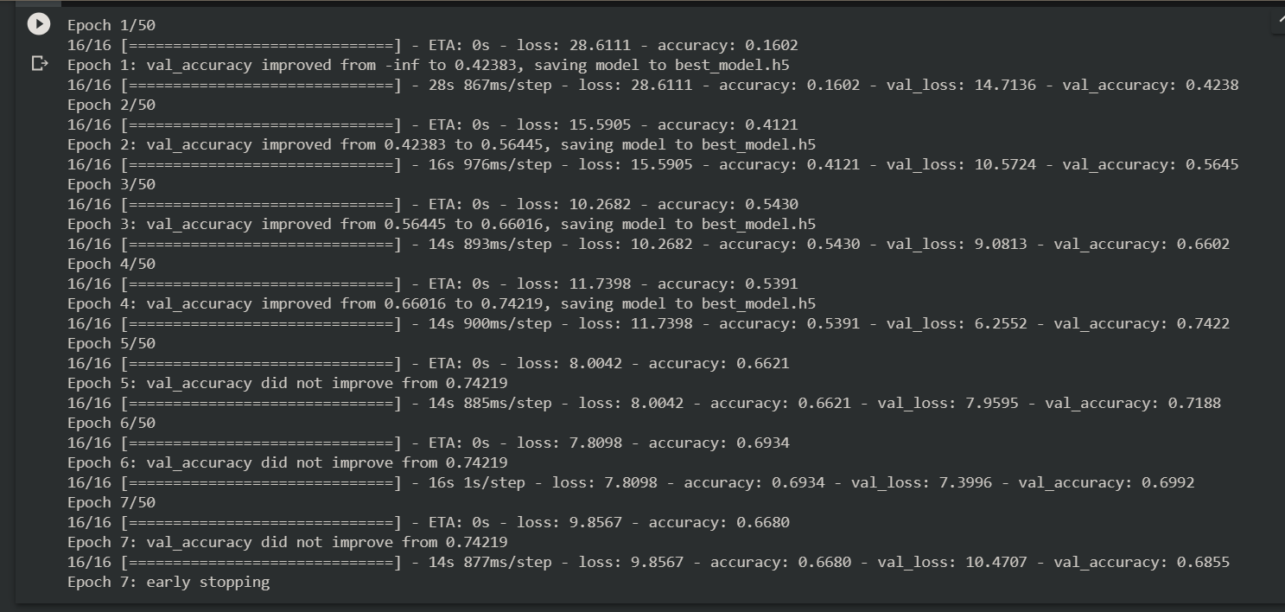
A photo of result is attached below.

Slide 11
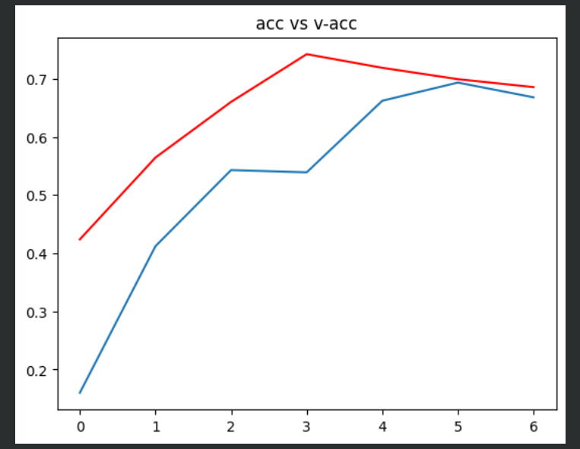
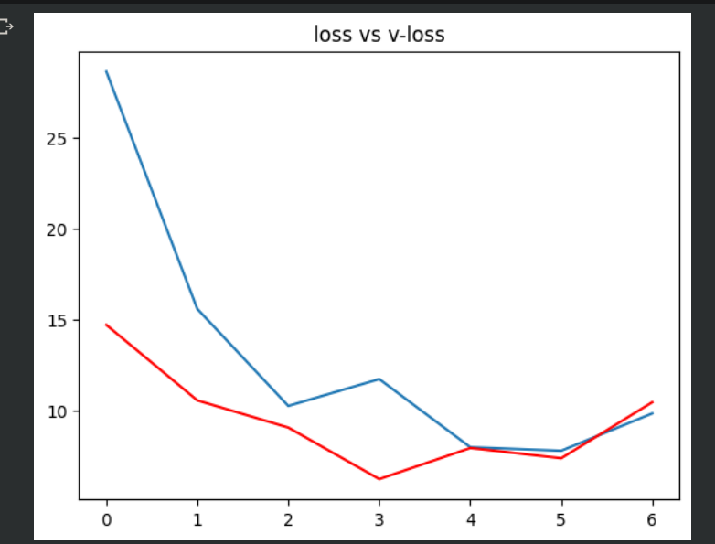
We plot a graph to illustrate the maximum accuracy the model achieved during training and validation while minimizing the loss.
From the above graphs, we observe that as the training accuracy increases, validation accuracy increases. Similarly as the training loss decreases, the validation loss decreases too.

Slide 12
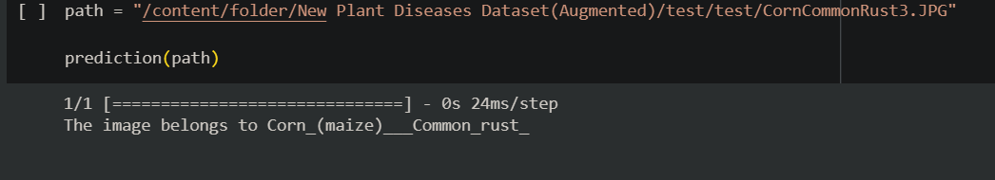
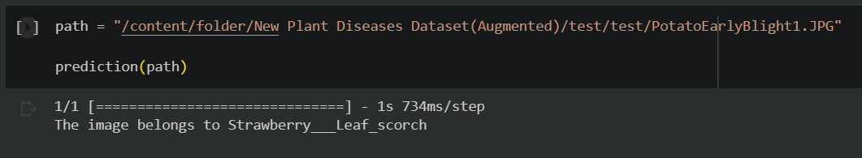
A simple demonstration of the design is shown in the following runner. Here we can see that how the basic implementation of the design is done. The output that we got after implementing the code:

Slide 13
By implementing a robust machine learning model such as CNN, the system can detect plant diseases at an early stage. Early detection enables farmers to take timely and targeted measures to effectively manage diseases.
Minimizing crop damage caused by diseases translates into better crop yields and higher profits for agricultural producers.

Slide 14
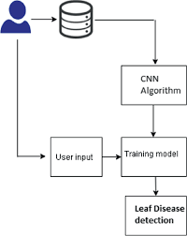
CONCLUSION
This project has successfully developed a plant disease prediction system using deep learning techniques. By incorporating the power of deep neural networks, the system can accurately classify and identify plant diseases based on input images of plant leaves. One of the key advantages of the deep learning-based system is its ability to handle a wide range of plant species and diseases.

Slide 15
FUTURE WORK
Potential future improvements to the plant disease prediction system include:
Data set expansion: Increase the size and diversity of the dataset to cover a wider range of plant species and diseases, allowing the system to handle a wider range of scenarios.
Real-time prediction: Develop a system capable of processing live image sources for real-time disease detection and early intervention.
Mobile application: Create a user-friendly mobile application that farmers can use to capture pictures of plant leaves and get instant disease predictions and recommendations.
Continuous model improvement: Implement techniques such as transfer learning and fine-tuning to increase the model's accuracy and robustness over time.
Multi-Sensor Integration: Integrating additional sensors, such as infrared or hyper spectral cameras, can provide additional information for more comprehensive disease diagnosis.
Multi-lingual Support: Enabling multi-lingual interfaces can make the system accessible to farmers from diverse linguistic backgrounds and ensure wider adoption.

Slide 16
THANK YOU

